Slide 1

Track
Me
From the Team
#include<idea.h>

Slide 2

I am
This is
And, That is
Hello!
Track Me
Surya Kiran
Abhishek
Akshay

Slide 3

Background

Slide 4


What do we do when we lose our phones?
Lost
Or
Police
Complaint
Internet
Tracking

Slide 5
What if I said that we could track your lost device without internet?

Slide 6

How are we are doing it?
Lost
GPS
SMS

Slide 7
Our process is easy
Send auth Key
(Savior)
Get coordinates
(Victim)
Receive Coordinates
(Saviour)

Slide 8
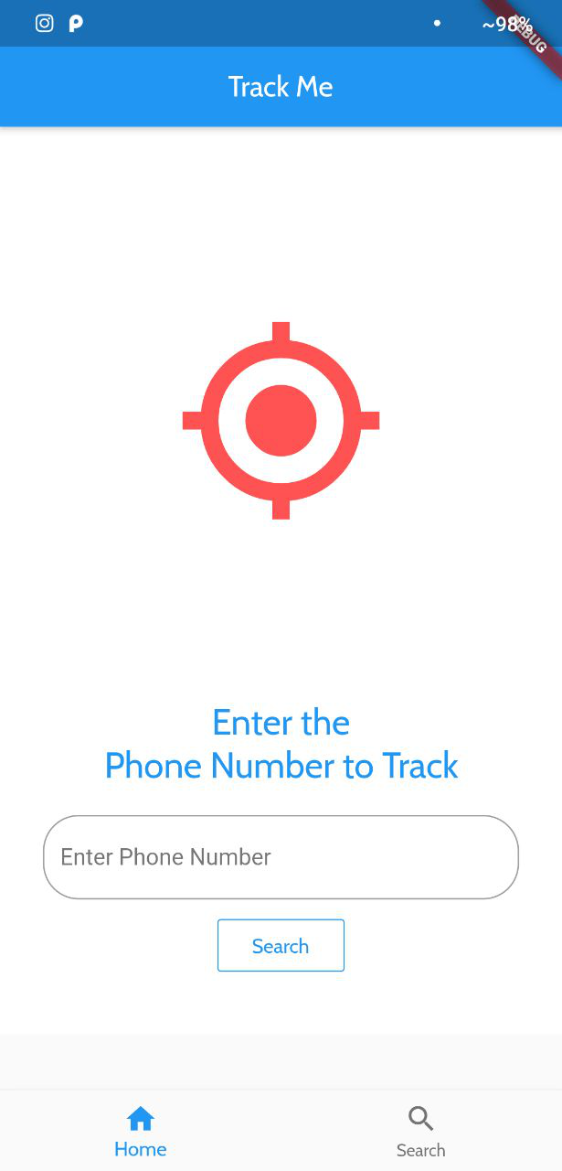
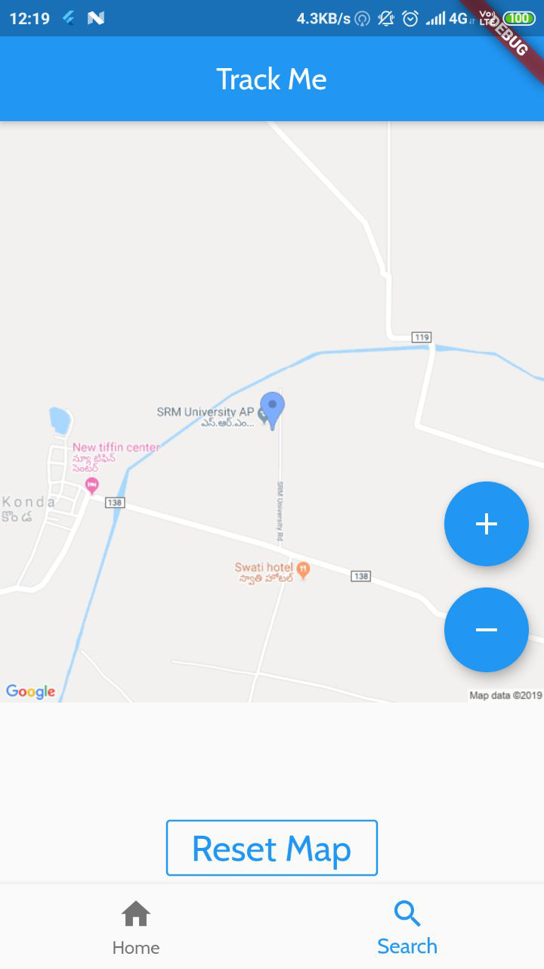
What has been implemented?
Phone number is provided
The location is displayed
As Simple as That!

Slide 9




What is yet to be implemented?
Auth
Database
Server Integration
Google
Directions
API

Slide 10


What can be implemented?
Remote Wipe
Women & Child Security

Slide 11

Android
iOS
Cross Platform Support

Slide 12
Limitations
Altitude cannot be determined accurately.
Slower Mode of Message Transmission
Cannot process live data

Slide 13
BIG PROBLEM
SIMPLE IDEA.
EFFICIENT SOLUTION.

Slide 14
Thanks!
Surya Kiran Suresh
skiran13@gmail.com
Abhishek Chandar
abhishekchandar23@gmail.com
Akshay Srinivasan
s.akshay0799@gmail.com

